Slide 1

WEB SCRAPING
Presented by,
BODDETI TANUJA LAKSHMI
BATCH: 2021-6313

Slide 2
CONTENT
What is Data Science?
Life cycle of Data Science
What is Scraping?
What is Web Scraping?
Architecture of Web Scraping
Uses of Web Scraping
Structured and Un-Structured data
6 reasons to use Python in Web Scraping
Why Python in Web Scraping?
Python libraries for Web Scraping
How does web scraping done with python?
Step-by-step web scraping example

Slide 3
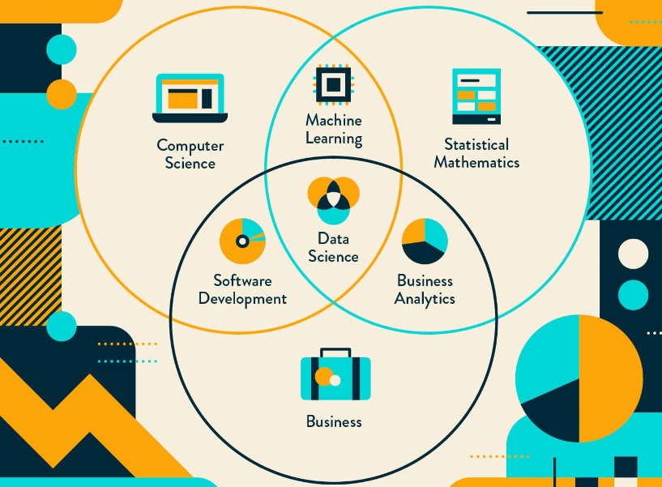
What is Data Science?
A multi-disciplinary field that uses scientific
methods and processes the algorithms and systems
to extract knowledge and insights from structured
and unstructured data.
The concept to unify statistics, data analysis,
machine learning and their related methods
is to understand and analyze actual phenomena
with data.
• There are many techniques and theories drawn
from many fields within the context of mathematics,
statistics, computer science, and information science.

Slide 4
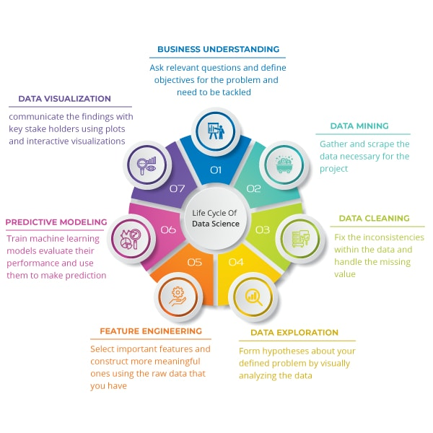
LIFE CYCLE OF DATA SCIENCE
There are 7 steps involved in life cycle of data science.
Business Understanding
Data Mining
Data Cleaning
Data Exploration
Future Engineering
Predictive Modelling
Data Visualisation

Slide 5
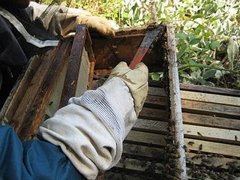
WHAT IS SCRAPING?
Converting data from human readable into machine readable.
This data is sometimes referred to as unstructured
but is really just not structured properly for systematic parsing.
The data is often embedded in layers of formatting meta data.
Think HTML or PDF formatting like font colors and tables.
The job of the scraper is to separate the data from the formatting.
In some cases even using the formatting to interpret the data.
Scraping propolis from the sides of the bee box

Slide 6
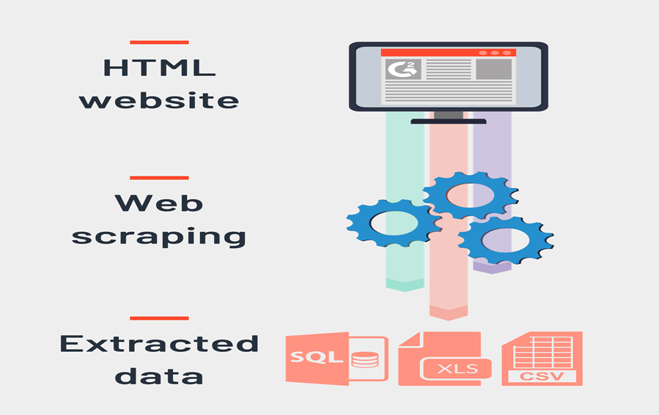
WHAT IS WEB SCRAPING?
Web Scraping refers to an application that processes the
HTML of a web page to extract data for manipulation such
as converting the web page to another
format (i.e. HTML to XML).
Web scraping is an automated method used to extract
large amounts of data from websites.
The data on the websites are unstructured.
Web scraping helps collect these unstructured data and
store it in a structured form.
It is also known as Web Harvesting and Web Data Extraction.

Slide 7
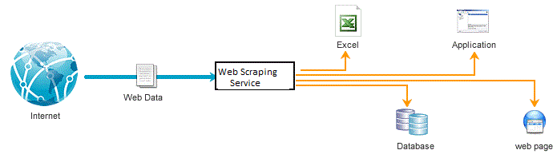
ARCHITECTURE OF WEB SCRAPING

Slide 8
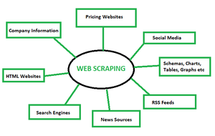
USES OF WEB SCRAPING

Slide 9
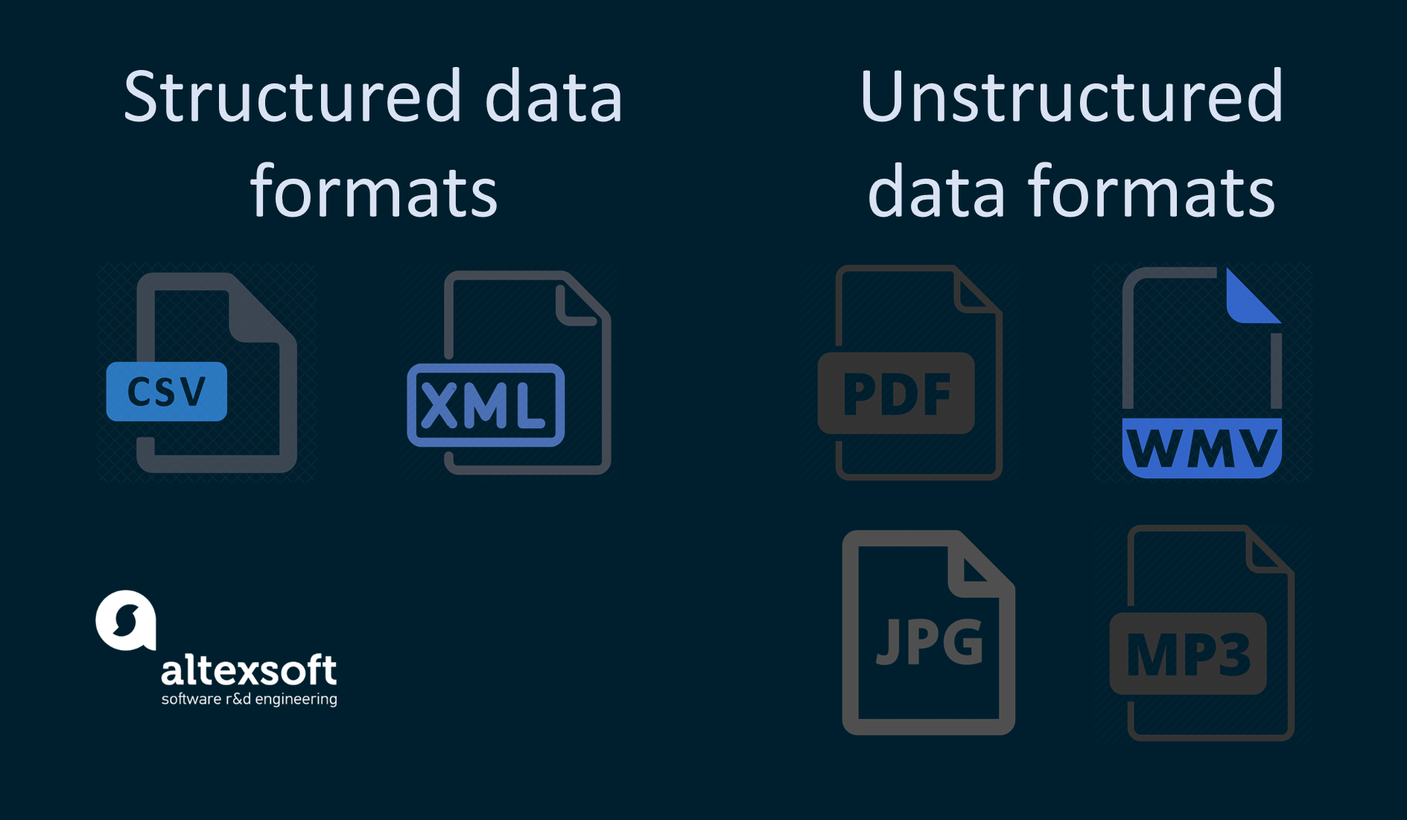
STRUCTURED AND UNSTRUCTURED DATA
Structured data stands for information that is highly organized,
factual, and to-the-point. It usually comes in the form of letters
and numbers that fit nicely into the rows and columns of tables.
Structured data commonly exists in tables similar to
Excel files and Google Docs spreadsheets.
Unstructured data doesn’t have any pre-defined structure
to it and comes in all its diversity of forms.
The examples of unstructured data vary from imagery
and text files like PDF documents to video and audio
files, to name a few.

Slide 10
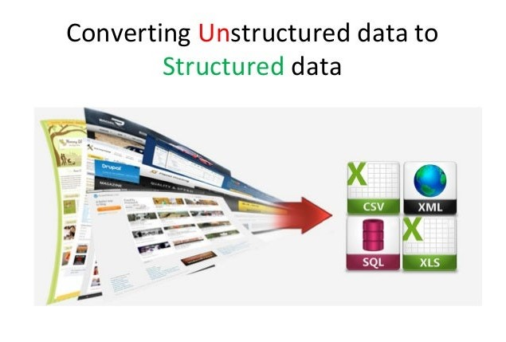
STRUCTURED AND UNSTRUCTURED DATA
Unstructured content is largely obtained
after the scraping process.
Structuring the data is the tedious process,
but nowadays most of the tools easily does this
functionality to segregate the data
based on the fields.
After the segregation the data is converted
into either an API or any other format like CSV,
XML, XLS, JSON

Slide 11
6 REASONS TO USE PYTHON FOR WEB SCRAPING
It has many specific features that make it the preferred choice for data collection and web scraping including:
Simplicity
Large libraries
Timely typing
Syntax is easily understood
Quick
Familiarity

Slide 12
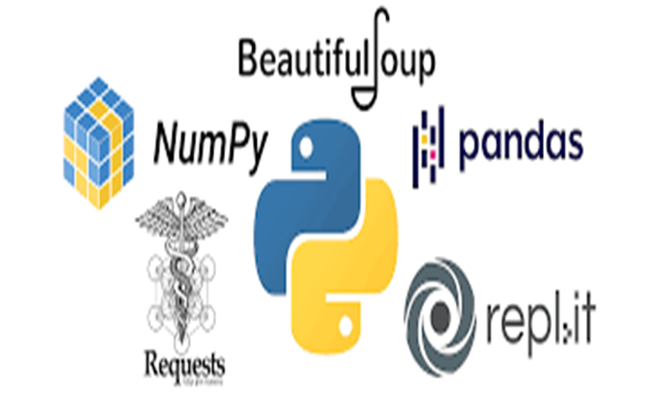
WHY PYTHON FOR WEB SCRAPING?
Python is great for collecting data from the web.
Python is unique as a programming language, in
that it has very strong communities for both
web programming and data analysis.
As a result, the entire computational research
pipeline can be integrated.
Instead of having separate applications for data
collection, storage, management, analysis and
visualization, you have one code-base.

Slide 13
PYTHON LIBRARIES FOR WEB SCRAPING
Requests (HTTP for Humans) : It is used for making various types of HTTP requests like GET, POST, etc. It is the most basic yet the most essential of all libraries.
lxml Library : lxml library provides super-fast and high-performance parsing of HTML and XML content from websites. If you are planning to scrape large datasets, this is the one you should go for.
Beautiful Soup Library : Its work involves creating a parse tree for parsing content. A perfect starting library for beginners and very easy to work with.
Selenium Library : Originally made for automated testing of web applications, this library overcomes the issue all the above libraries face i.e. scraping content from dynamically populated websites. This makes it slower and not suitable for industry-level projects.
Scrapy : The BOSS of all libraries, an entire web scraping framework which is asynchronous in its usage. This makes it blazing fast and increases efficiency.

Slide 14
HOW DOES WEB SCRAPING DONE WITH PYTHON?
Once the code is written and run, a request for scraping is sent to your website of choice.
If the request is approved, the server will send the desired data, allowing you to read the HTML or XML page. The code then automatically analyses the HTML or XML page, finds and parses the desired data.
The 5 basic steps of web scraping with Python:
Step 1: Choose the URL from which you would like to scrape
Step 2: Read the page and find the data you would like to collect
Step 3: Write the code
Step 4: Run the code to extract the data
Step 5: Store the data in the necessary format
It is important to bear in mind that while certain sites allow web scraping freely, others may block you from doing so.
In order to find out if a website blocks for web scraping, you can check the website’s “robot.txt” file.
You can find this file by adding “/robots.txt” to the URL of the website you wish to scrape.
For example, if you would like to scrape data from ikea.com, you would type www.kayak.com/robot.txt into the address bar.

Slide 15
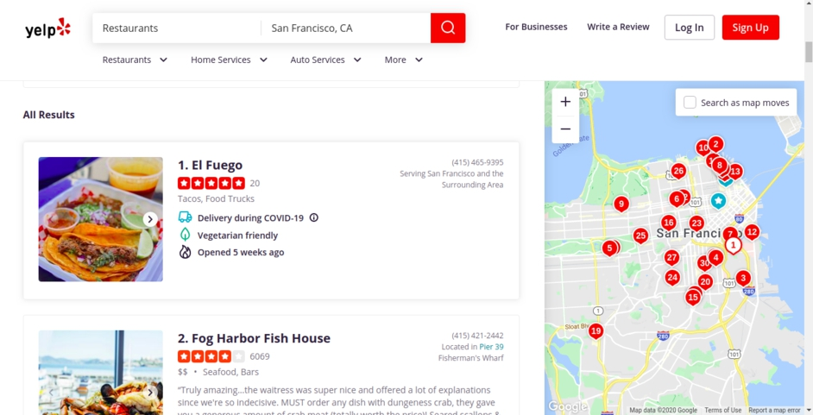
STEP-BY-STEP WEB SCRAPING EXAMPLE
We will be scraping Yelp for restaurant
reviews in San Francisco, California
with Scrapy.
Step 1: Since we are only fetching
restaurant reviews in San Francisco,
scraping URL will redirect
us to the page below.

Slide 16
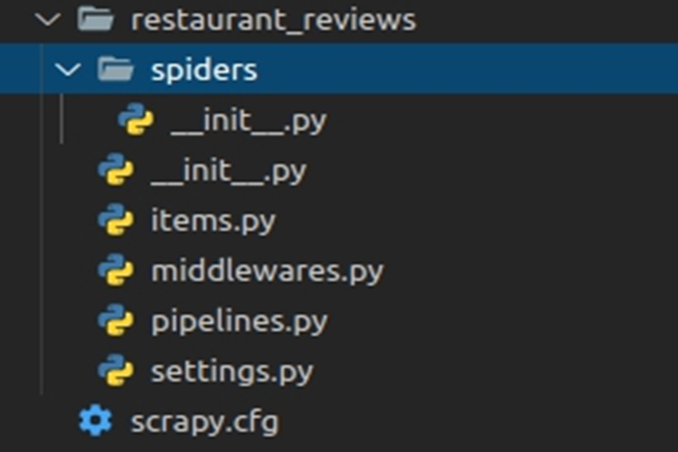
STEP-BY-STEP WEB SCRAPING EXAMPLE
Step 2: We will now create a Scrapy project with the command below Scrapy startproject restaurant_reviews Scrapy project structure

Slide 17
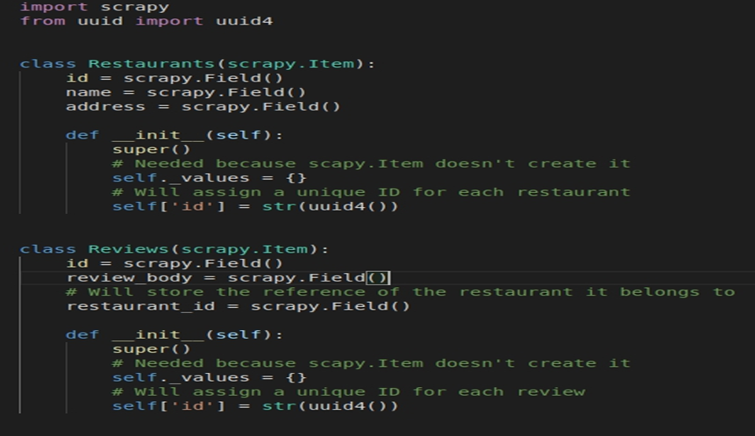
STEP-BY-STEP WEB SCRAPING EXAMPLE
Step 3: Now we will create 2 items (Restaurant and Review) in items.py to store and output the extracted data in a structured format.

Slide 18
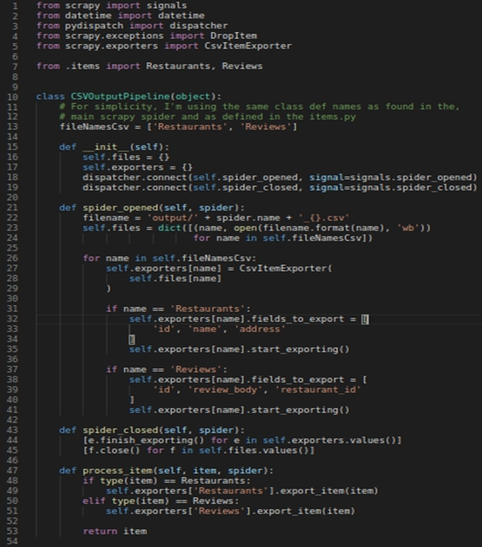
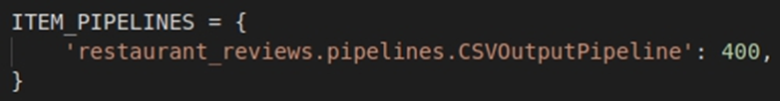
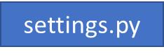
STEP-BY-STEP WEB SCRAPING EXAMPLE
Step 4: Now we will create a custom pipeline, in Scrapy to output data in 2 separate CSV files (Restaurants.csv & Reviews.csv)
After creating the custom pipeline we will add it in ITEM_PIPELINES of Scrapy settings.py file.

Slide 19
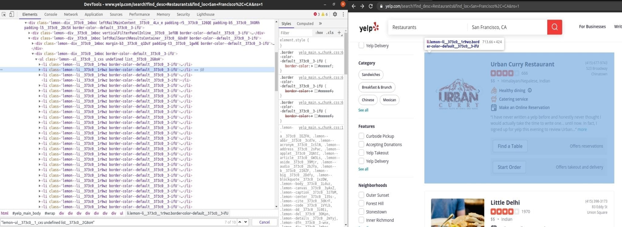
STEP-BY-STEP WEB SCRAPING EXAMPLE
Step 5: Now we will inspect the Yelp page we are going to scrape and find the and will find the URL for each restaurant’s review page from where we will fetch the reviews.
In the below image, we can see that all the search results are in <li> tags with the same CSS classes. In the same manner, we will inspect the review pages of some restaurants to understand their structure.

Slide 20
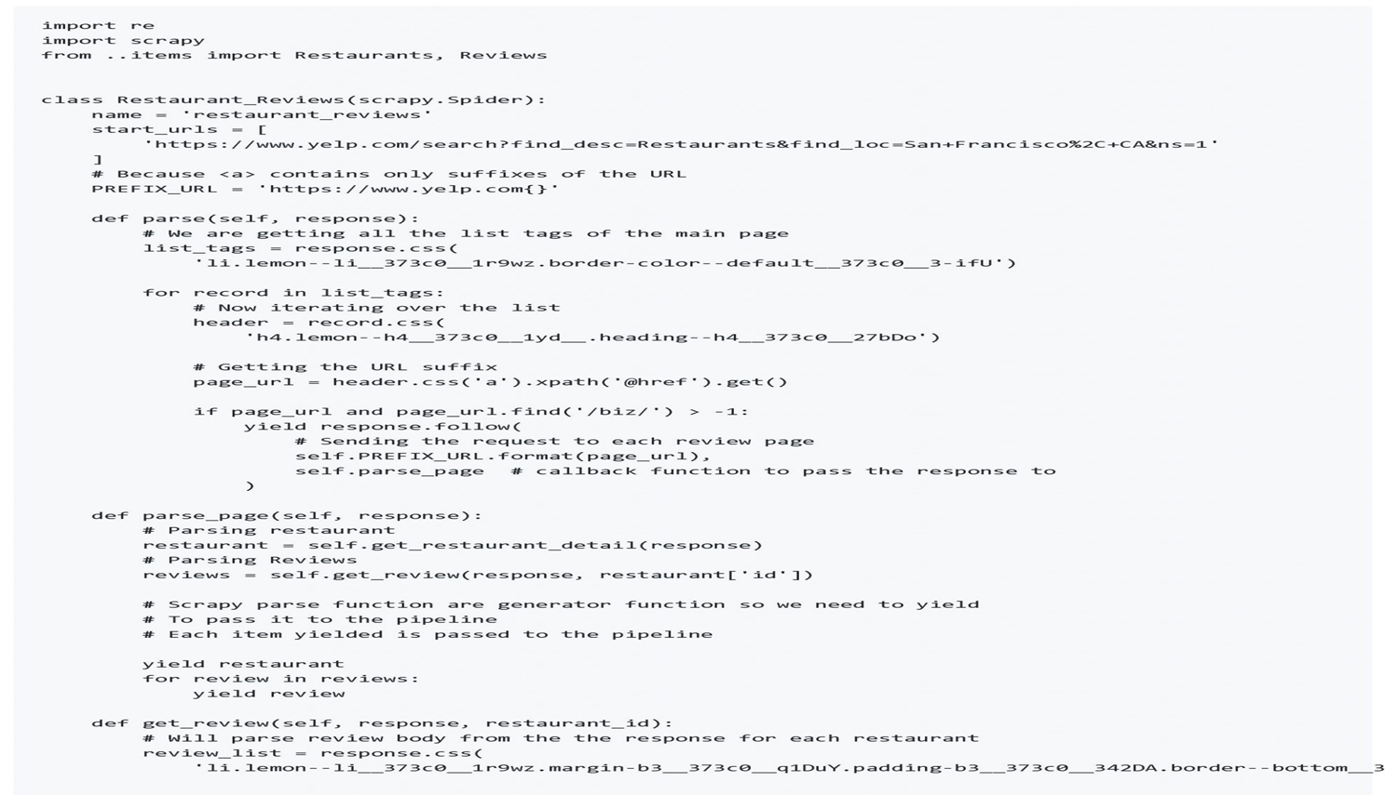
STEP-BY-STEP WEB SCRAPING EXAMPLE
Step 6: Now we will create a scraper to fetch the information.

Slide 21
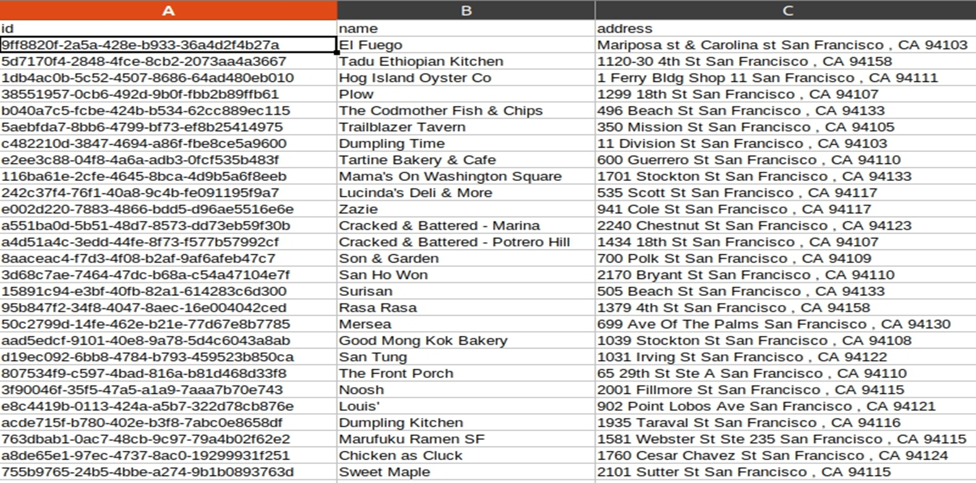
STEP-BY-STEP WEB SCRAPING EXAMPLE
Output: 1. Restaurants.csv Here we can see all the restaurants fetched.

Slide 22
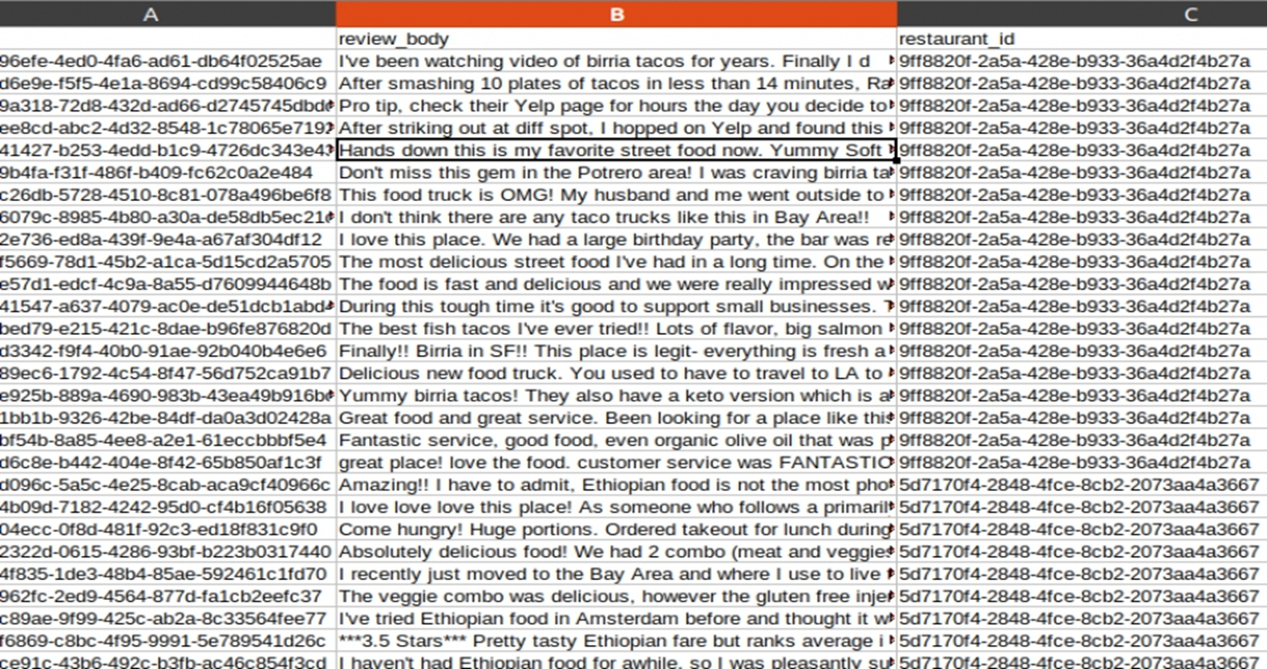
STEP-BY-STEP WEB SCRAPING EXAMPLE
2. Reviews.csv Here we can see the reviews with their restaurant references.

Slide 23
CONCLUSION
Web scraping with Python can be a powerful tool to get us the information we need in a straight forward and simple manner.
A web scraper, even one with legitimate purposes and no intent to bring a website down, can exhibit similar behavior and, if we are not careful, result in our computer being banned from accessing a website.
There may be a lot of web scraping disadvantages and advantages that are present currently. But scraping is the way forward, and it has a drastic and great effect on organizations who want data Web Scraping is a completely legal process.

Slide 24
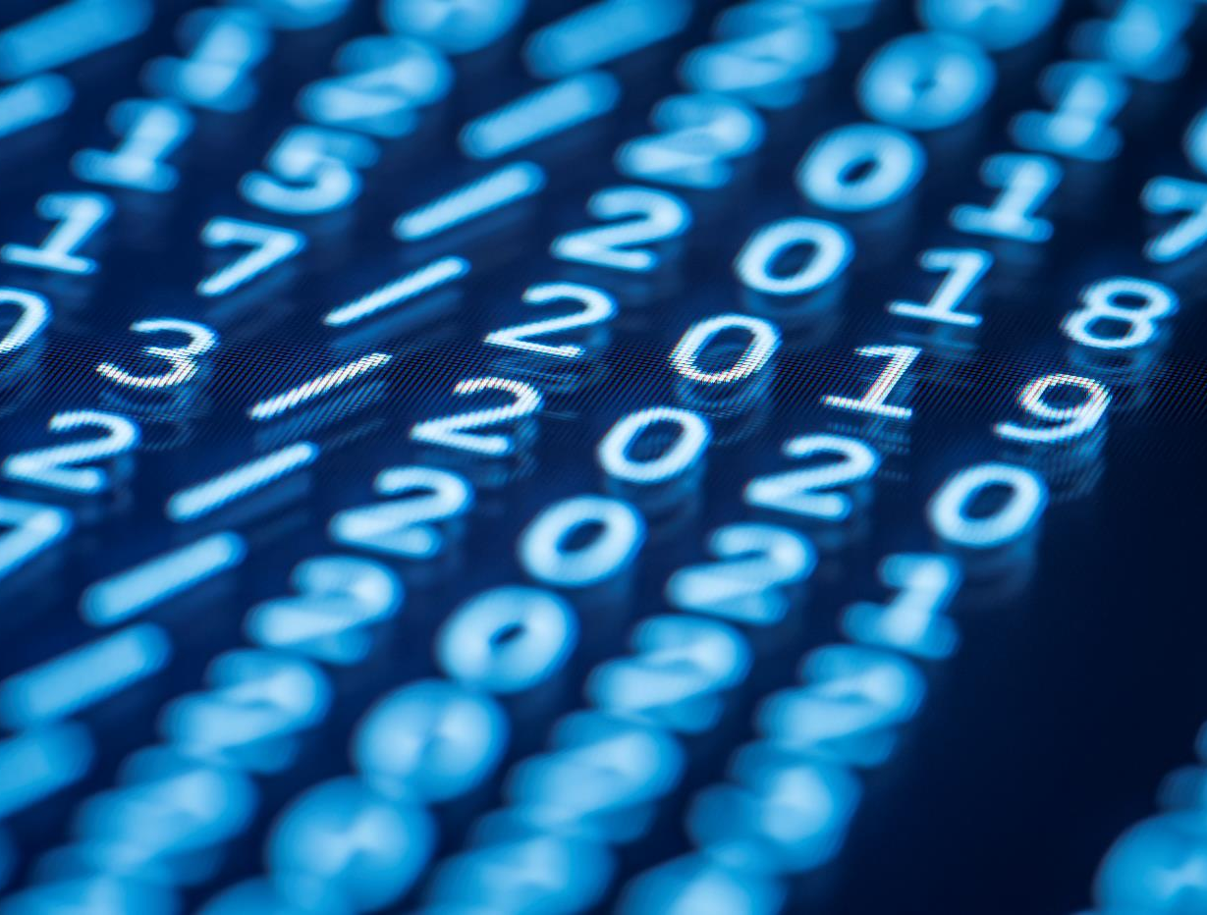
Thank You

